Slide 1




Lecture 1
Introduction to Operations Management

Slide 2
Course Structure
Module 1: Introduction & Operational Planning
Introduction to OM
Process Structures
Module 2: Capacity Planning
Lean & Six Sigma
Product & Service Design
Facility Location Planning
Module 3: Product & Service Delivery
Module 4: Control & Sustainability
Service Delivery
Distribution & Inventory Management
Demand & Revenue Management
Operations Strategy
Supply Chain Strategy
Globalization & Sustainability
Process Flow Analysis
2

Slide 3
Learning Objectives
Identify what products and services are and their characteristics.
Explain what operations management is and why it is important.
Describe the common challenges that operations managers have faced.

Slide 4

Operations Management at its best:
Apple’s Success Story
PRODUCT DESIGN/MIX
VOLUME
LOW COST SUPPLY
DEMAND
VISIBILITY
SUPPLIERS
“Operations expertise is as big an asset for Apple as product innovation or marketing.”

Slide 5
Operations Management (OM)
is everywhere – Part I
PRODUCTS: Everything you wear, eat, sit on or in, use, read, or knock about on a sports field comes to you courtesy of operations.
SERVICES: Every book you borrow from the library, every medical treatment you receive, every lecture you attend at a university, every service you receive comes to you courtesy of operations.

Slide 6
Characteristics of Products & Services
Product / Goods
Services
Core Goods
Core Services
Tangible
Can be inventoried
Little customer contact
Long lead time
Often capital-intensive
Quality easily assured
Material is transformed
Intangible
Cannot be inventoried
Extensive customer contact
Short lead time
Often labor intensive
Quality harder to assess
Information or customer is transformed
6

Slide 7
Manufacturing and Services Continuum of Characteristics
Service
Orientation
Mining (coal)
Automobiles
Fast Food
Banking
Consulting
Manufacturing
Orientation

Slide 8
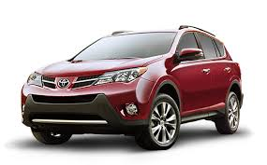

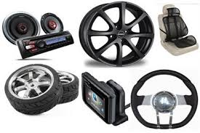
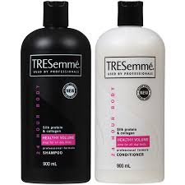
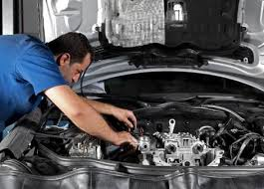

Service-Product Bundle
Element | Core Goods Example | Core Service Example
Business | Automobile (e.g. Toyota) | Hair Salon
Core | Motor cars | Hair treatment
Non-core Goods | Car accessories | Shampoo & conditioner
Non-core Service | Warranty / Maintenance service | Manicure
Goal: Add value to customers

Slide 9
Goods vs. Services:
Total Product Experience
Total product experience refers to all the outputs of an operation, both goods and services, that are combined to define a customer’s complete consumption experience.
The experience includes all aspects of purchasing, consuming, and disposing of the product.
9

Slide 10
Operations Management (OM)
is everywhere – Part II
OM
Schools
Construction
Restaurants
Hospitality
Banks
Military
Agriculture
Transportation
Health
Care
Sport Teams
Municipalities
Government
Services
Manufacturers
Not-for-Profit
Organizations
Entertainment
Retail
10

Slide 11

Operations Management (OM):
A Basic Definition
Operations Management (OM): is the management of processes used to design, supply, produce, and deliver valuable goods and services to customers

Slide 12




What is Operations?
Inputs
Transformation
Outputs
A process is a system of activities that transforms inputs into valuable outputs.
12

Slide 13
What is Operations? (Cont’d)
INPUTS
OUTPUTS
Materials
Goods
Labor
Transformation
Processes
Capital
Services
Knowledge

Slide 14
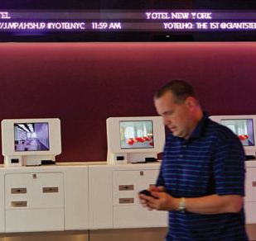
Operations Management (OM):
Common Challenges
Lowering costs
Improving quality
Enhancing product desirability
Aligning OM with the company’s competitive strategy
Evolving with the needs of customers, competition, and technology

Slide 15
Why study OM?
OM involves using resources and managing organizational relationships
When done well, effective OM can:
Use resources more efficiently
Improve business processes effectiveness
Improve relationships between business entities
Help meet strategic goals
Increase customer service

Slide 16
Key Take-away
Characteristics of Products & Services
Service-Product Bundle
OM definition and challenges

Slide 17
Appendix

Slide 18
Careers in Operations Management

Slide 19
Careers in Operations Management
Plant manager
Hospital administrator
Branch manager
Department store manager
Call center manager
Supply chain manager
Purchasing manager
Business process improvement analyst
Quality control manager
Lean improvement manager
Project manager
Production control analyst
Facilities manager
Chief Operating Officer
Business
Consultant
Hotel Front Office Manager

